Slide 1
Cryptanalysis
Cryptanalysis is the science and art of deciphering or breaking codes and ciphers, often with the goal of recovering the original plaintext or uncovering sensitive information.
Here are some key concepts and techniques associated with cryptanalysis:
Brute Force Attack
Dictionary Attack
NFC Credit Card

Slide 2
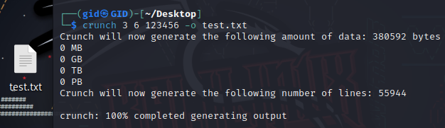
Brute Force Attack
This is the simplest form of cryptanalysis, where an attacker tries every possible key or combination until the correct one is found.
Now to try the brute force attack first of all we need the encrypted file and also, we need a wordlist so let's see how to make a wordlist:

Slide 3
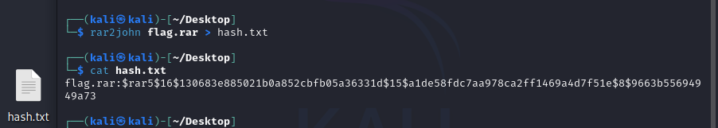
Brute Force Attack
Ok now we have the encrypted file and the wordlist but what to do?
First of all, we need to get the file hash to compare it with the passwords to get the correct one.

Slide 4
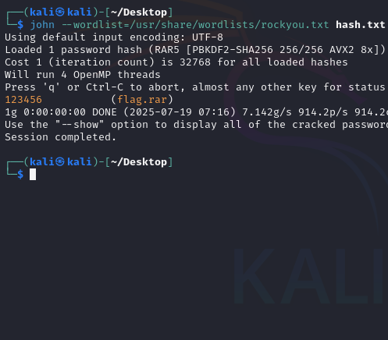
Brute Force Attack
Now the last step we need to do is get the hashes file with the wordlist and use the john the ripper tool to brute it.

Slide 5
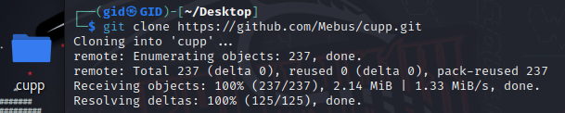
Dictionary Attack
A dictionary attack is a type of brute force attack in the context of password cracking and encryption. It involves trying to gain unauthorized access to a system or decrypt data by systematically trying all the words or phrases in a dictionary or wordlist.

Slide 6
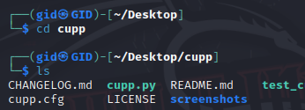
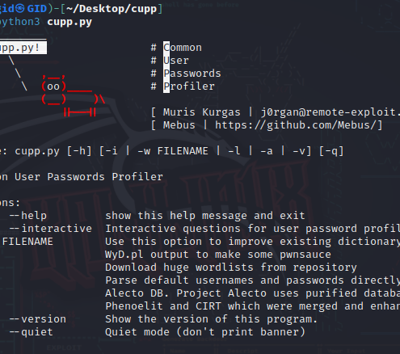
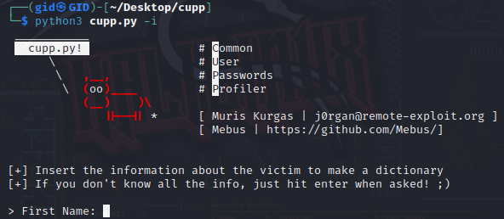
Dictionary Attack

Slide 7
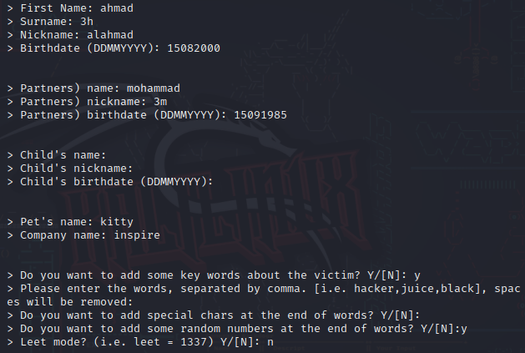
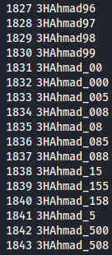

Dictionary Attack

Slide 8
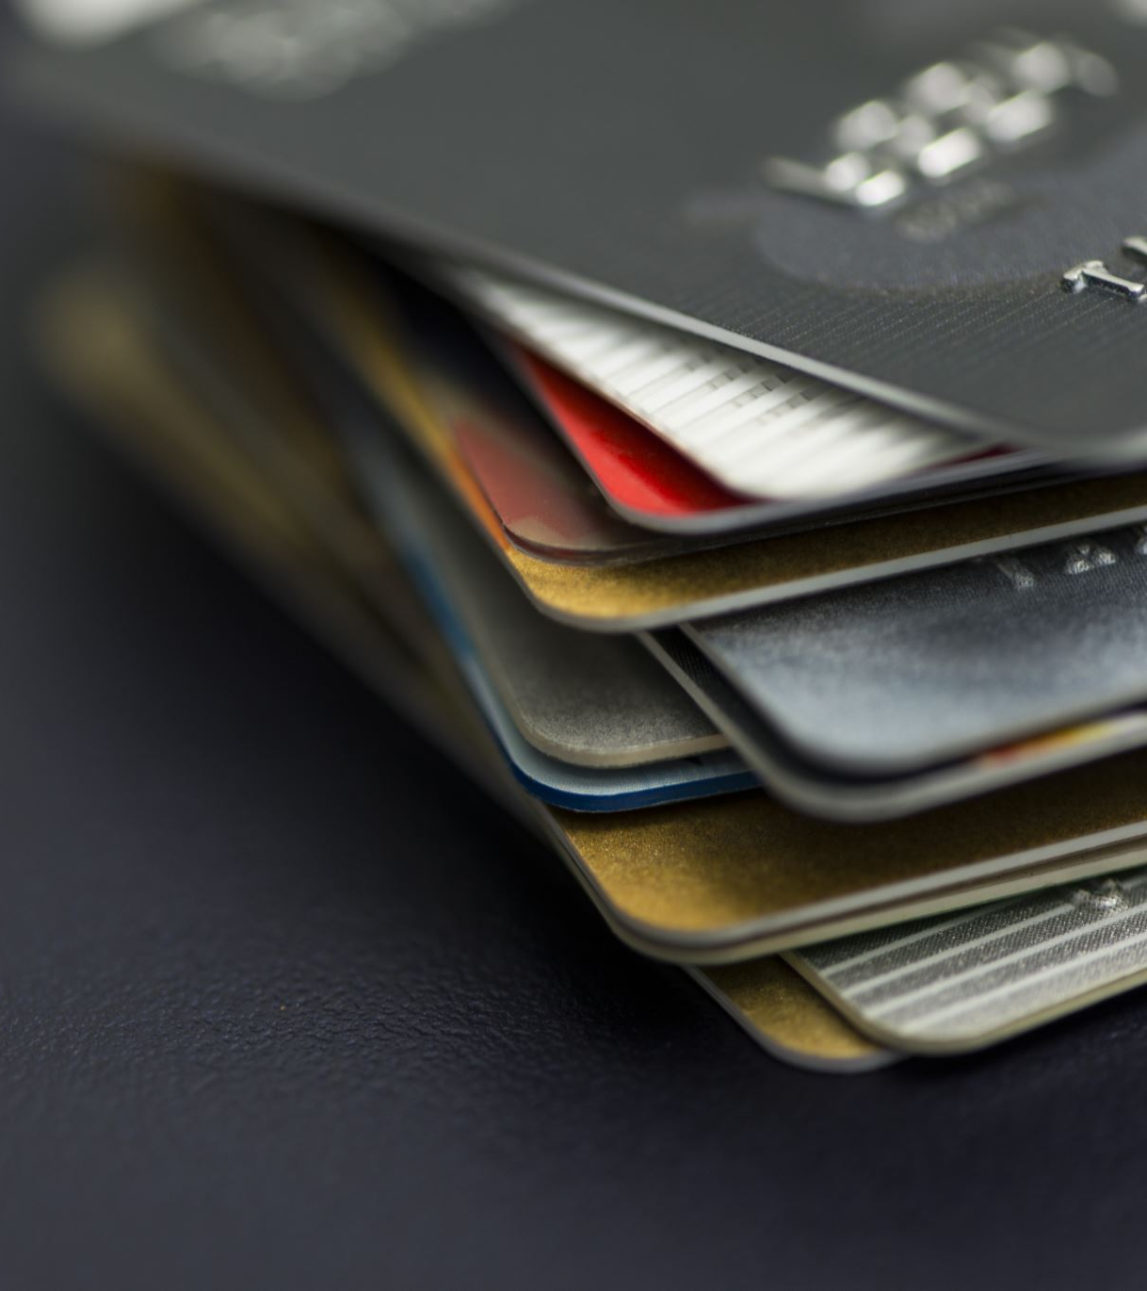
NFC Credit Card
An NFC (Near Field Communication) credit card is a type of credit card that incorporates NFC technology to enable contactless payments. NFC is a short-range wireless communication technology that allows data to be exchanged between two devices when they are in close proximity, typically within a few centimeters.
Contactless Payments: NFC credit cards are equipped with an embedded NFC chip and antenna. To make a payment, a cardholder can tap or hold the card near an NFC-enabled payment terminal. The card and terminal establish a secure communication link to process the transaction.
Security: NFC credit cards use encryption and authentication mechanisms to secure transactions. Each transaction generates a unique code, making it difficult for attackers to intercept and clone card data.
Mobile Wallet Integration: Many NFC credit cards can also be added to mobile wallet apps, such as Apple Pay, Google Pay, or Samsung Pay. This allows users to make contactless payments using their smartphones or smartwatches instead of the physical card.

Slide 9
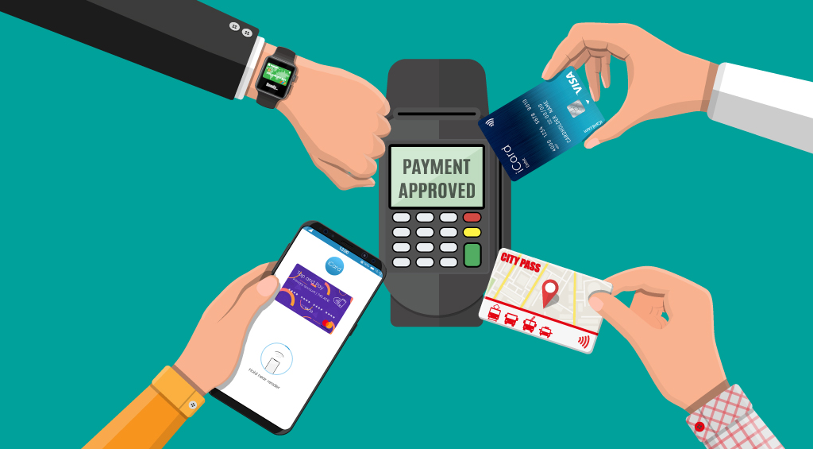
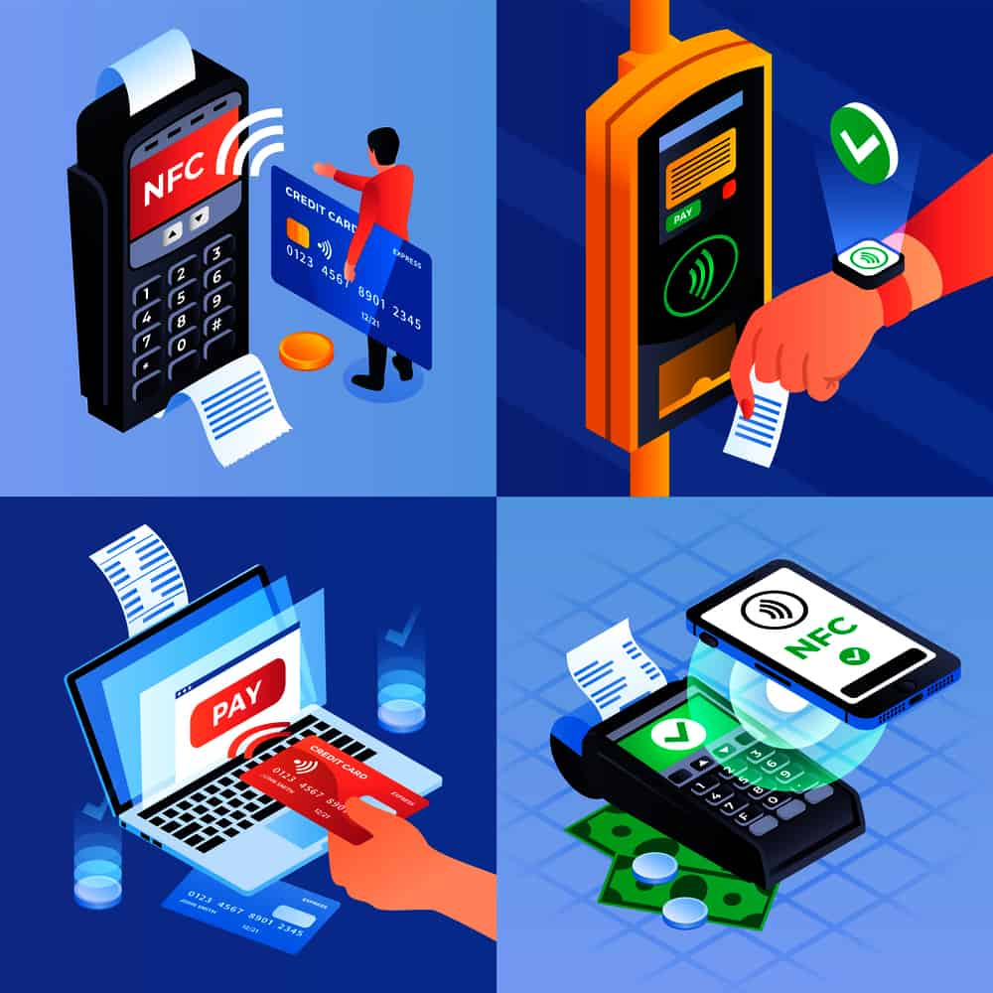
NFC Credit Card

Slide 10
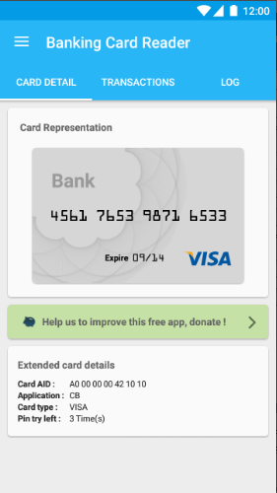
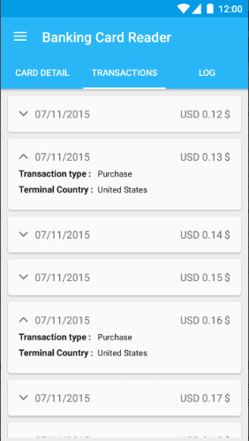
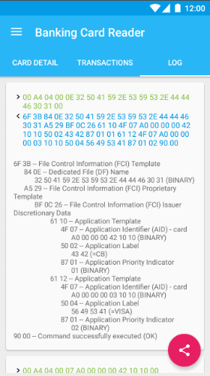
NFC Credit Card

